Slide 1
SMART SHOE FOR BLIND PEOPLE
Guided by: Prof. Rupali Patil
Submitted by:
Ms.Sayali Baviskar.
Ms.Suchita Katela.
Mr.N.S Krishna.

Slide 2
WHAT IS SMART SHOE?
Smart shoe is specialy designd for blind people.
It has been designed and developed to provide safe navigation.
Provides obstacle detection and avoidance.
Provide emergency message alert through GPS.
shoe can be connected via bluetooth to set the directions.

Slide 3
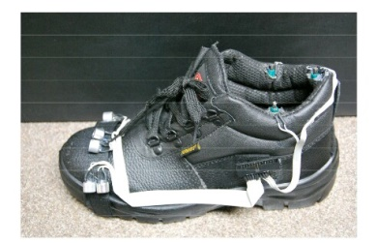
THE INSTRUMENTED SHOE

Slide 4
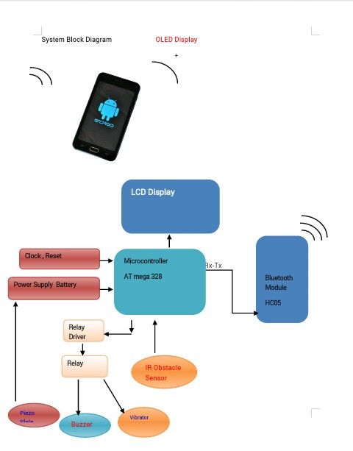
BLOCK DIAGRAM OF SMART SHOE

Slide 5
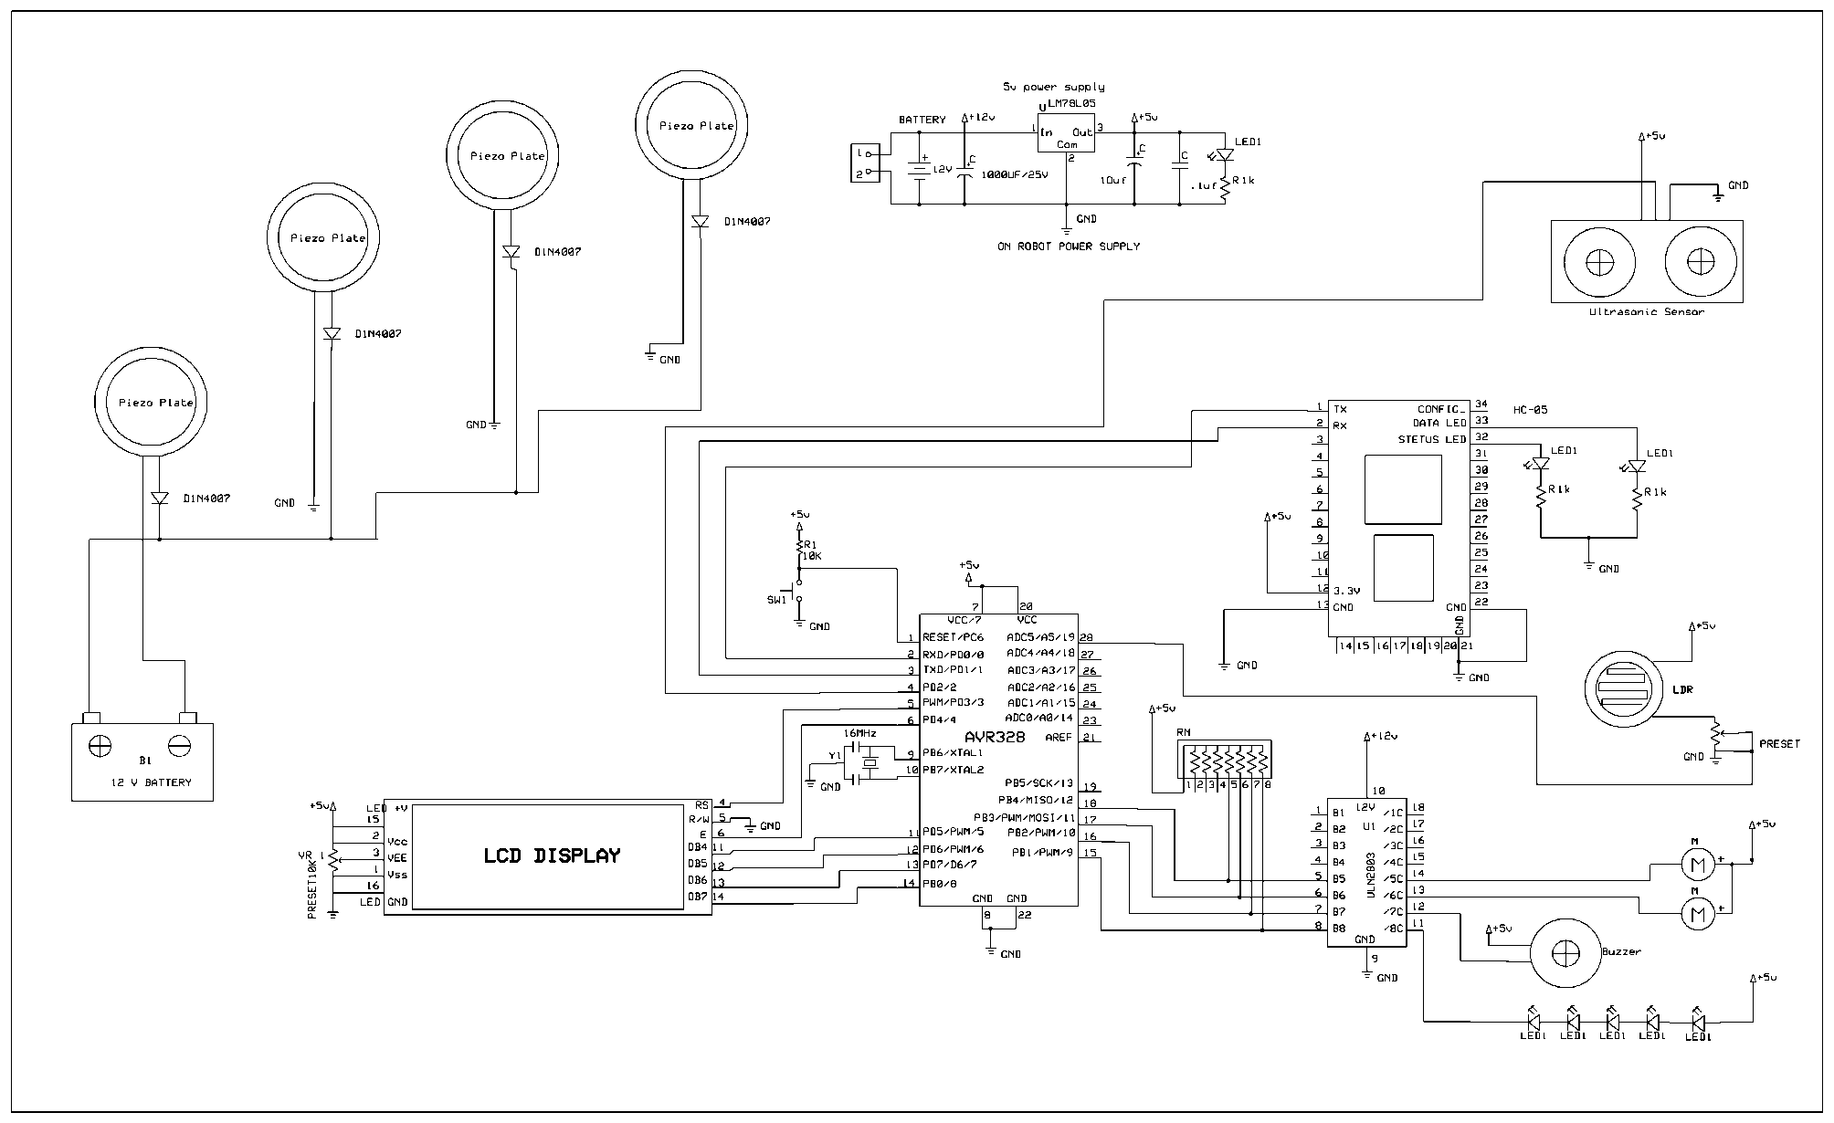
CIRCUIT DIAGRAM

Slide 6
The circuit is divided into two parts
1. Transmitter
2. Receiver
TRANSMITTER
For transmitter section, the different commands signals are transmitted via RF transmitter module of 433 MHz.
it has 4 pins of antenna, Vcc, Gnd, & serial data input
The output modulating frequency is decided by resistor connected at OSC pin of the encoder.

Slide 7
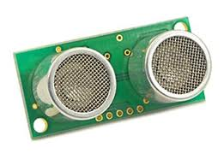
RECEIVER
On receiver side the data is received by RF receiver module of 433 MHz .
This demodulated signal is fed to decoder for further decoding.
The decoded by decoder is fed to uC for further control of relay.
IC ULN2803 amplifies signal coming from controller & controls as per controller instruction.
Ultrasonic sensor(Transmitter and receiver)

Slide 8
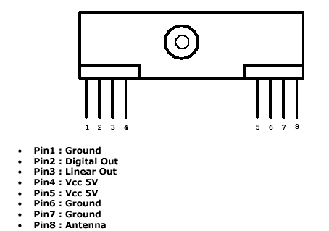
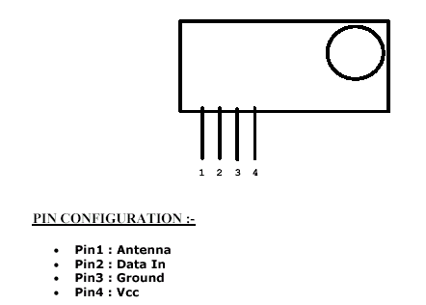
TRANSMITTER MODULE RECEIVER MODULE
The transmitter module is only 1/3 the size of a standard postage stamp.
The receiver also operates at 433.92MHz, and has a sensitivity of 3uV.
The RWS-434 receiver operates from 4.5 to 5.5 volts-DC, and has both linear and digital outputs.

Slide 9
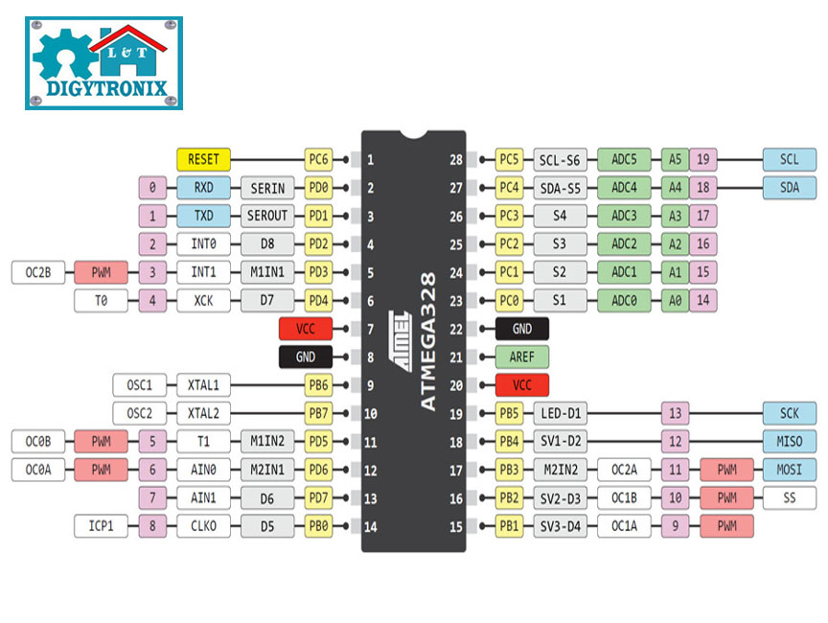
CONTROLLER : ATMEGA328

Slide 10
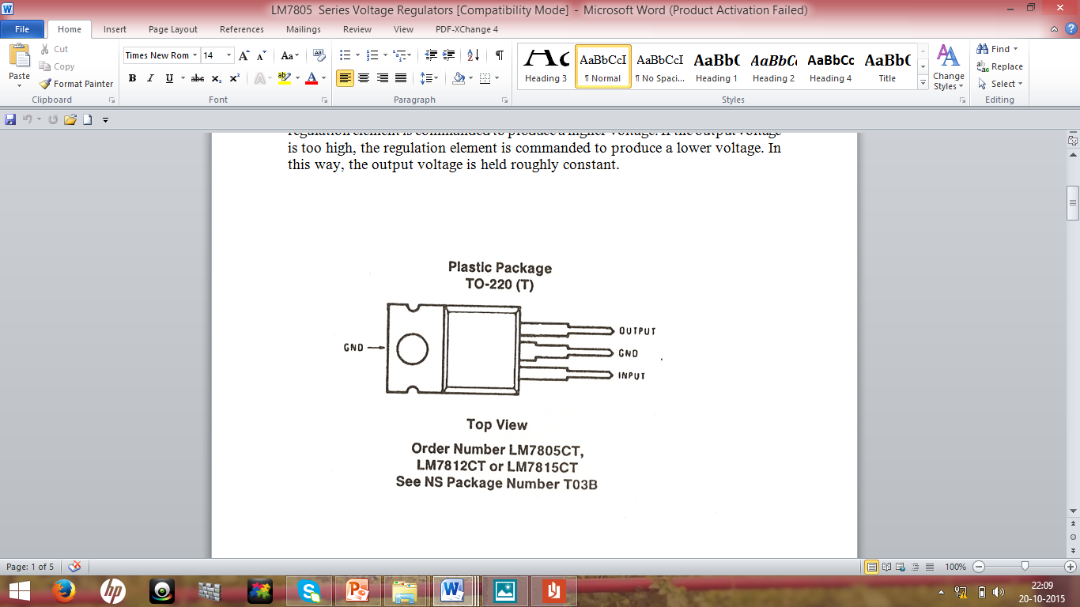
LM7805 Series Voltage Regulators
A voltage regulator is an electrical regulator designed to automatically maintain a constant voltage level.
The LM78XX series of three terminal regulators is available with several fixed output voltages making them useful in a wide range of applications.

Slide 11
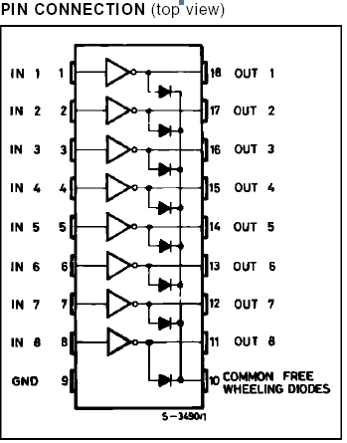
Relay Driver
ULN2803
The eight NPN Darlington connected transistors in this family of arrays are ideally suited for interfacing between low logic level digital circuitry (such as TTL, CMOS or PMOS/NMOS) and the higher current/voltage requirements of lamps, relays, printer hammers or other similar loads for a broad range of computer, industrial, and consumer applications.

Slide 12
VIBRATING MOTORS
Vibrating motor is a normal DC motor with off center load applied to it.
When 1 is received transistor gets on and motor starts roatating.
As it is provided with off center Loade it starts vibrating because of load on one side only.
These motors are implemented on front, left, right side of the shoe.
The vibrations of the motor will navigate the person to reach the destination.

Slide 13
Concept of off centererd loading
Off cenetr load is a basically a mechanical concept.
A vibrating motar is a motar that is improperly balanced.
There an off-centered weight attached to the motar’s rotational shaft that causes the motar to wobble.
The amount of wobble can be changed by the amount of weight u attach, the weight’s distance frome the shaft, and the speed of at whivh motars spins.

Slide 14
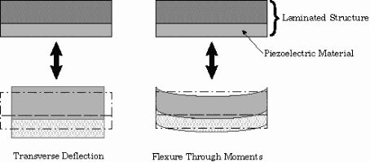
PIEZO ELECTRIC PLATES
Piezo electric plates are the plates which produce voltages in response to applied mechanical force.
It will produce power using vibrations produced during walking
It will produce upto 7 volts which will be regulated by voltage regulater and store in battery
Thsese voltages will be used to drive the circuit.

Slide 15
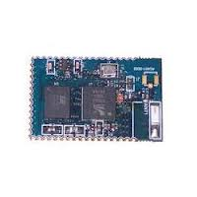
BLUETOOTH MODULE(HC05)
Here we use one android mobile which is connected to the circuit via bluetooth.
We build one mobile app and using a software B4A (Basics for android)
With the help of GPS the app will trace the location of the person whenever needed.
In case of emergency it will send the massage with location on other phone (Home).

Slide 16
About B4A
B4A stands for Basics of android.
B4A - The simplest way to develop real-world, native Android apps.
B4A includes all the features needed to quickly develop any type of Android app.
B4A can run in two modes: local compilation and remote compilation.
Local compilation mode is faster and has more options such as working with the emulator, USB debugging, unattended installations and others.
Remote compilation mode (only available in the trial version) is simpler to get started with.

Slide 17
FEATURES OF SMART SHOE
Obstacle detection.
Warn of impending obstacle.
Guidance around the obstacles.
Capable of voice input operations.
Wayfinding.

Slide 18
Route recall .
Operational flexibility.
User friendliness.
Comfortable to use.
Good battry life.

Slide 19
LIMITATIONS
It will navigate through the prespacified routes only.

Slide 20
Reference
1.Basic Electronics – B.Ram
2.Digital Electronics – R.P.Jain
3. Design and Development of a Prototype Rehabilitative Shoes and Spectacles for the Blind(IEEE PAPER 2012).

Slide 21
THANK YOU !!!

